Slide 1
Лекция Введение в HADoOP Знакомство с HIVE
Методы и инструменты анализа больших данных

Slide 2

Что это
Структурированное хранилище данных поверх неструктурированного HDFS
The Apache Hive ™ data warehouse software facilitates reading, writing, and managing large datasets residing in distributed storage using SQL. Structure can be projected onto data already in storage. A command line tool and JDBC driver are provided to connect users to Hive. Apache Hive TM
Notes:
https://cwiki.apache.org/confluence/display/Hive/Presentations

Slide 3
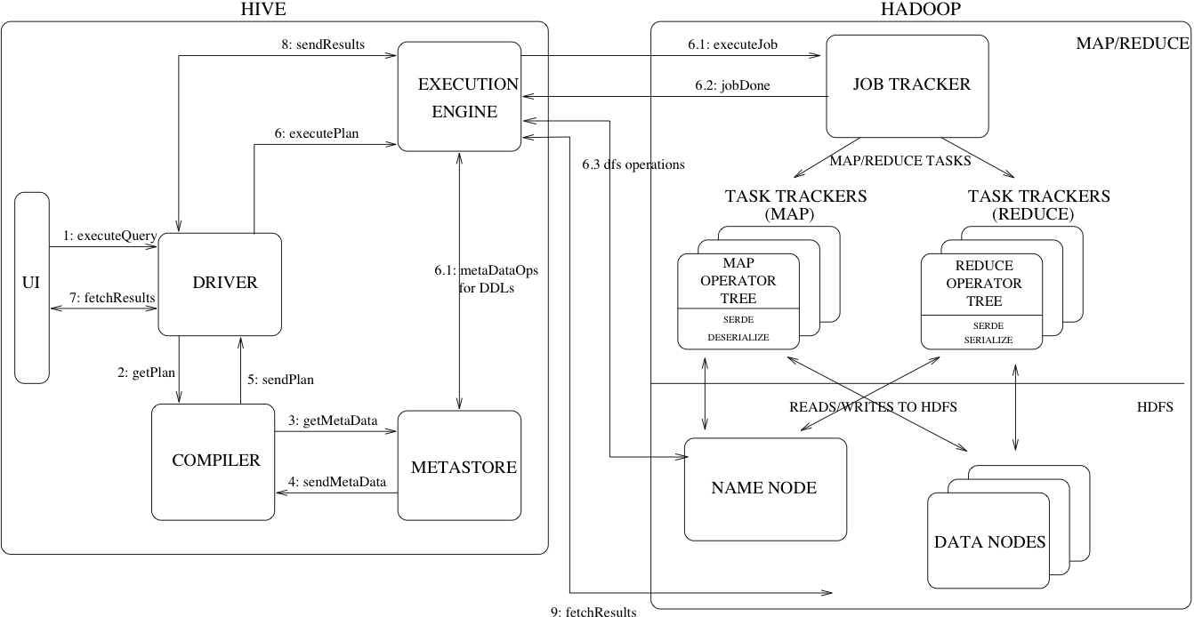
Архитектура

Slide 4
Hive Architecture
UI – The user interface for users to submit queries and other operations to the system. As of 2011 the system had a command line interface and a web based GUI was being developed.
Driver – The component which receives the queries. This component implements the notion of session handles and provides execute and fetch APIs modeled on JDBC/ODBC interfaces.
Compiler – The component that parses the query, does semantic analysis on the different query blocks and query expressions and eventually generates an execution plan with the help of the table and partition metadata looked up from the metastore.
Metastore – The component that stores all the structure information of the various tables and partitions in the warehouse including column and column type information, the serializers and deserializers necessary to read and write data and the corresponding HDFS files where the data is stored.
Execution Engine – The component which executes the execution plan created by the compiler. The plan is a DAG of stages. The execution engine manages the dependencies between these different stages of the plan and executes these stages on the appropriate system components.
Notes:
https://cwiki.apache.org/confluence/display/hive/design#Design-Metastore

Slide 5
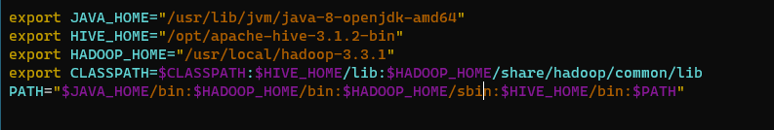
Установка
Настроить среду (java, пользователи и т.д)
Скачать бинарники (выбрать версию подходящую к версии HADOOP)
Создать хранилище в HDFS
hdfs dfs -mkdir /hive /hive/warehouse
Установить postgres для metastore
sudo -i -u postgres
ALTER USER postgres WITH PASSWORD 'password’;
Настроить environment
Notes:
http://mtitek.com/tutorials/bigdata/hive/install.php#sec_id_4

Slide 6
Конфигурация
Пример лежит hive-default.xml.template
Будем использовать postgres
vim ${HIVE_HOME}/conf/hive-site.xml
vim ${HIVE_HOME}/bin/hive-config.sh
${HIVE_HOME}/bin/schematool -initSchema -dbType postgres

Slide 7
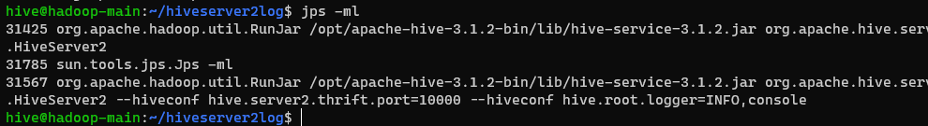

Журналирование
mkdir ~/hiveserver2log
ls -al /tmp/ | grep hive

Slide 8
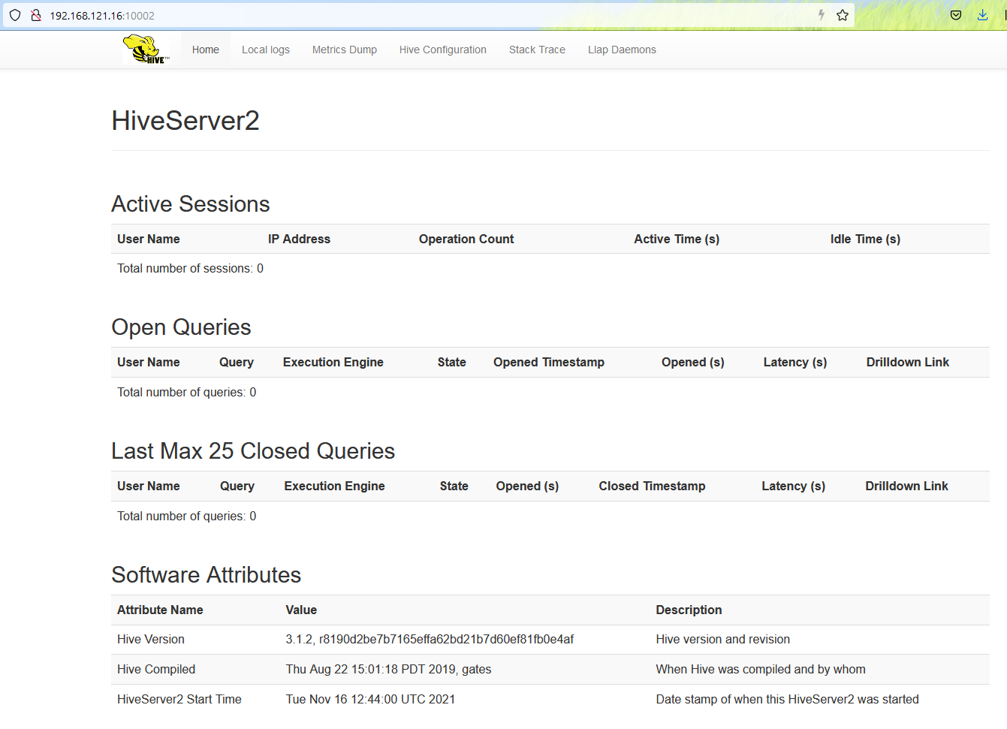
Журналирование

Slide 9
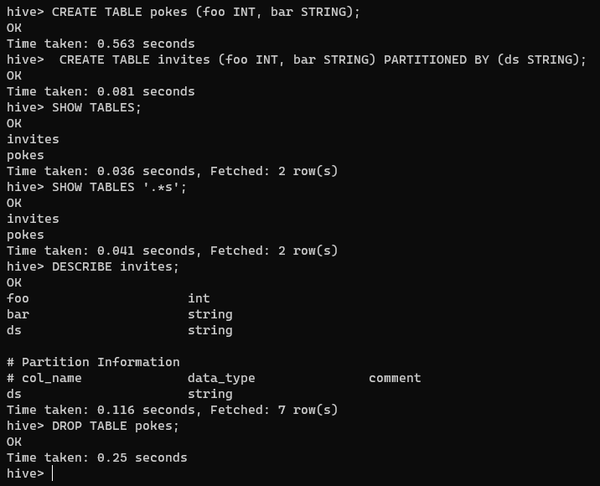
запуск
$hive

Slide 10
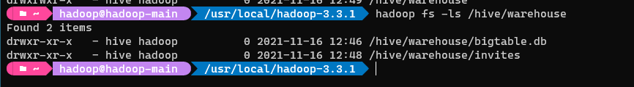
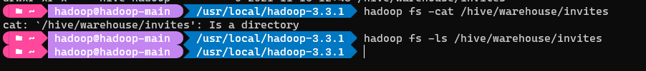
Как это “легло” в HDFS

Slide 11
Как это “легло” в HDFS

Slide 12
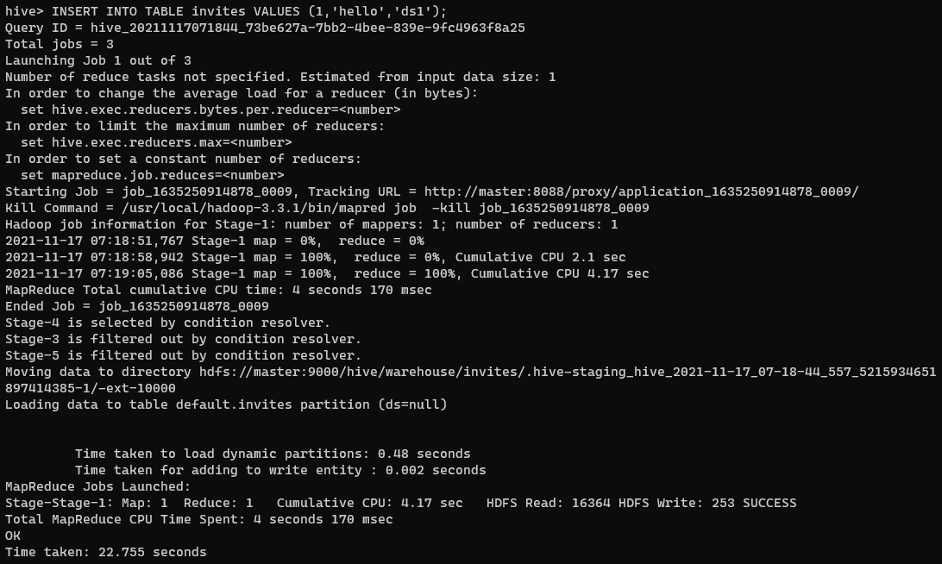
Как это “легло” в HDFS

Slide 13
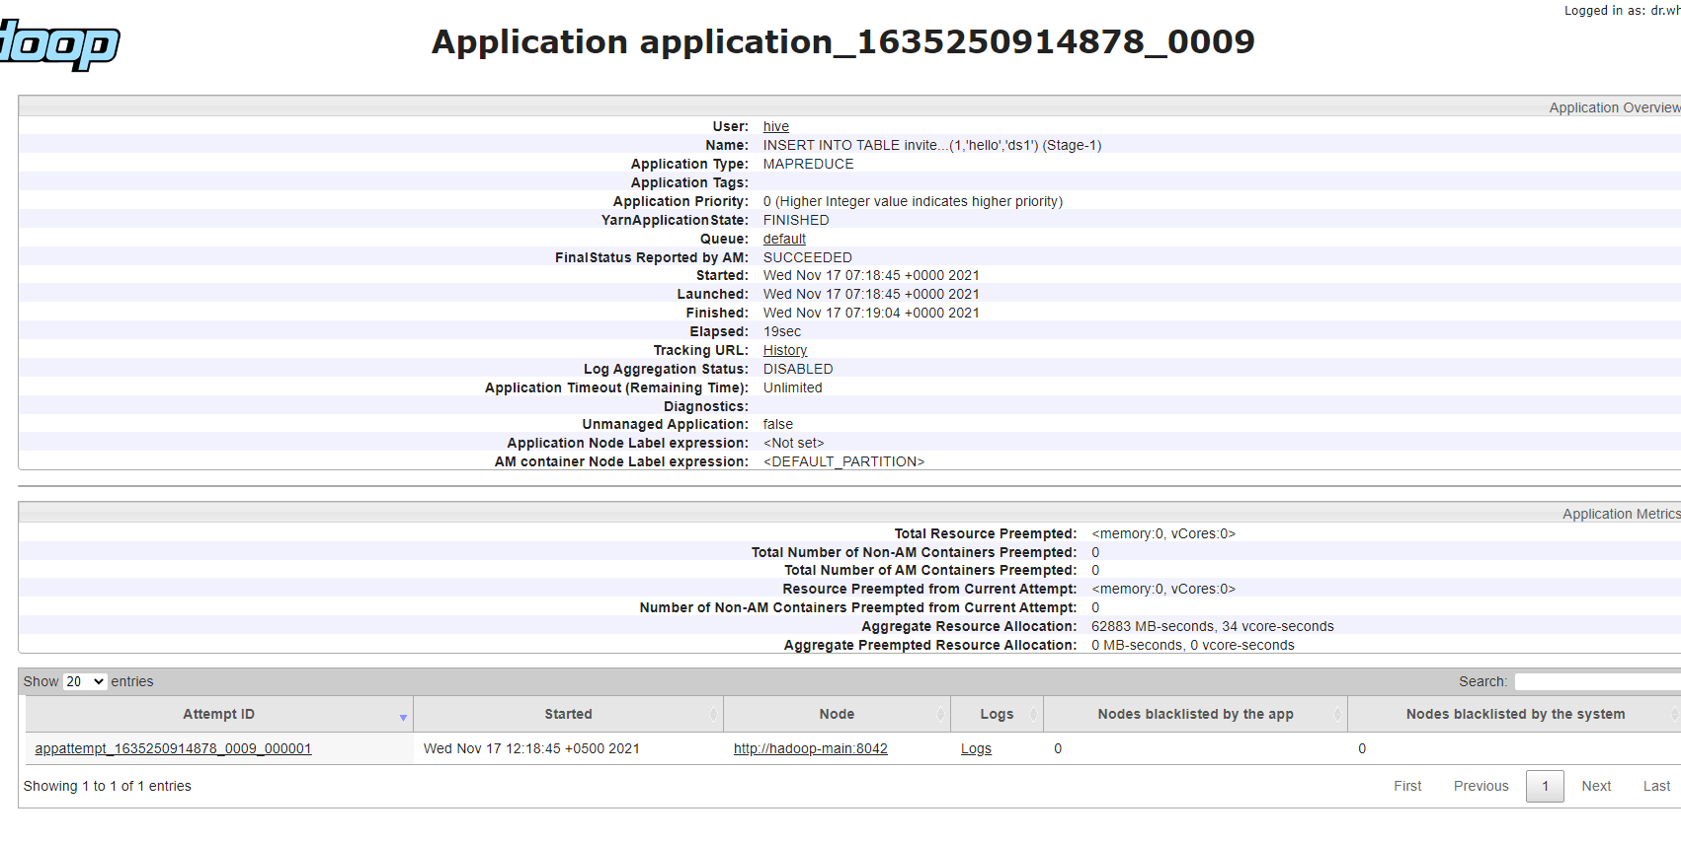
Как это “легло” в HDFS

Slide 14
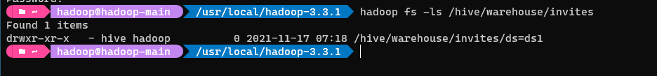
Как это “легло” в HDFS

Slide 15
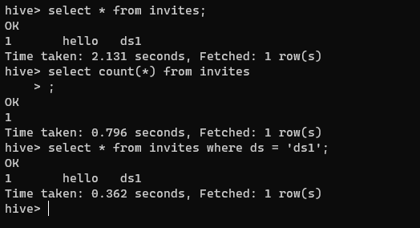
Выберем
Notes:
https://cwiki.apache.org/confluence/display/Hive/HiveServer2+Clients#HiveServer2Clients-Beeline%E2%80%93CommandLineShell

Slide 16
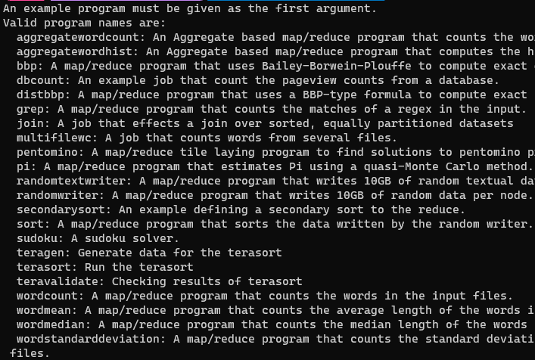
Mapreduce\yarn
export YARN_EXAMPLES=${HADOOP_HOME}/share/hadoop/mapreduce
yarn jar ${YARN_EXAMPLES}/hadoop-mapreduce-examples-3.3.1.jar
Notes:
https://hadoop.apache.org/docs/stable/hadoop-mapreduce-client/hadoop-mapreduce-client-core/MapReduceTutorial.html#Example:_WordCount_v1.0

Slide 17
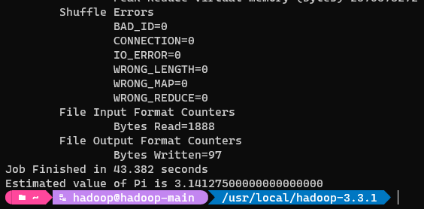
Mapreduce\yarn
yarn jar ${YARN_EXAMPLES}/hadoop-mapreduce-examples-3.3.1.jar pi 16 10000
yarn jar ${YARN_EXAMPLES}/hadoop-mapreduce-examples-3.3.1.jar pi 16 100000

